Slide 1
Communicating with Data – Introduction to Interactive Visualization
Dr. Ab Mosca (they/them)
Slides based off slides courtesy of Jordan Crouser (https://jcrouser.github.io/)

Slide 2


Announcements
Congrats on an exceptional job on the Mid-semester Project! I’m super proud of the work you did, and I hope you all are, too!
Remember to fill out your reflection on Gradescope

Slide 3
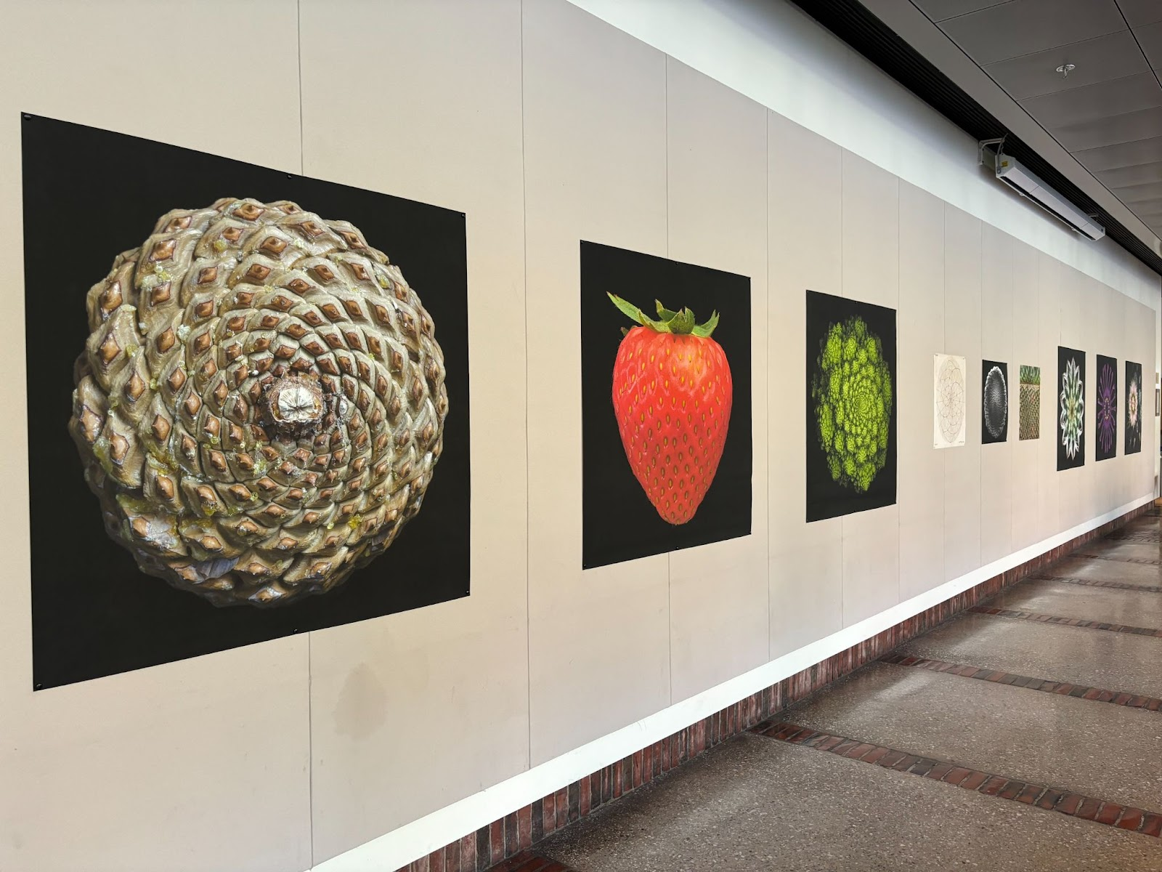
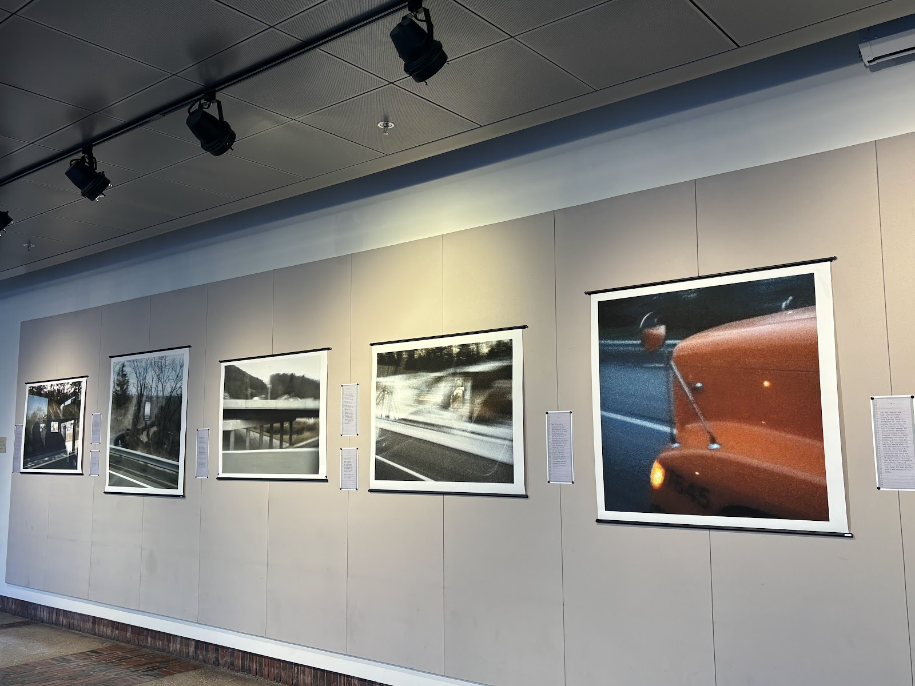
Announcements
Smith Office for the Arts (SOFA) is accepting proposals for the McConnell Foyer Gallery
I think a visualization installation would be a great fit for the space. If you’d like to brainstorm and submit a proposal with me, please reach out on Slack
Do Plants Know Math?: Unwinding the Story of Plant Spirals from Leonardo to Now
BUS: A Teacher in Transit

Slide 4
Announcements
On 11/07 we will have a guest lecture from the Spatial Analysis Lab (SAL) on geospatial visualization
Please bring a laptop to class if you’re able to

Slide 5
Reminder
HW 04 is (finally!) due this week
Remember, it was delayed so that we could cover interaction; consider adding what we learn today to your story if you already made one
Post your finished story on Tableau Public, and turn in a link to the story on Gradescope. Instructions for posting are under In-class on the course website (tableau-public-demo.pdf) and the hw04.pdf has been updated.

Slide 6
Plan for Today
Interaction: a definition
Interaction with data and problem space
Relationship between interaction and understanding
Interaction with visual interfaces
Basic interaction types
Demo: coordinated multiple views

Slide 7


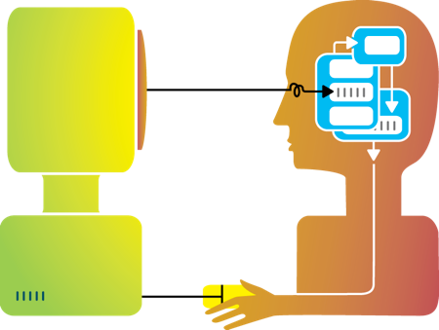
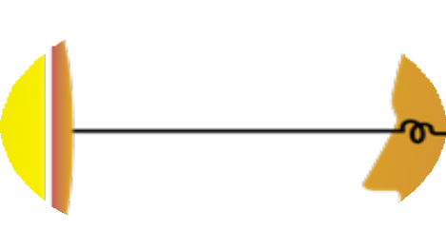
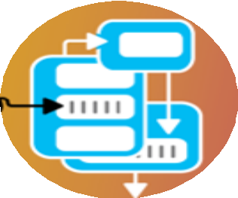




Rewind
Humans and machines have complimentary strengths
Visualization
Perception
and context
Interaction
Computational power
Image credit: Ali Ansari

Slide 8
Interaction (def.)
“Interaction for visualization is the interplay between a person and a data interface involving a data-related intent, at least one action from the person and an interface reaction that is perceived as such.”
Mandatory Components
Interplay
Person
Data Interface
Action
Action-Reaction
Reaction Perceived as Such
Data-Related Intent
What is Interaction for Data Visualization? Evanthia Dimara, Charles Perin. 2020
Notes:
Interplay – “dialogue”
Person -
Data Interface– the vis
Action – Any action, physical or mental, regardless of modality that causes the reaction of the data interface
Action-Reaction– cause effect between entities
Reaction Perceived as Such – person must perceive the reaction in the data interface
Data-Related Intent – intent is tied to a data source and is formed iteratively throughout the interaction cycle

Slide 9
Methods by which humans create knowledge through the manipulation of an interface
Low level: between human and interface
the set of operations available
the relationship between the human and the visualization
High level: between human and problem space
a cognitive act enabled by the tool
does not need to take place exclusively within them
might be distributed across multiple tools
Interaction

Slide 10
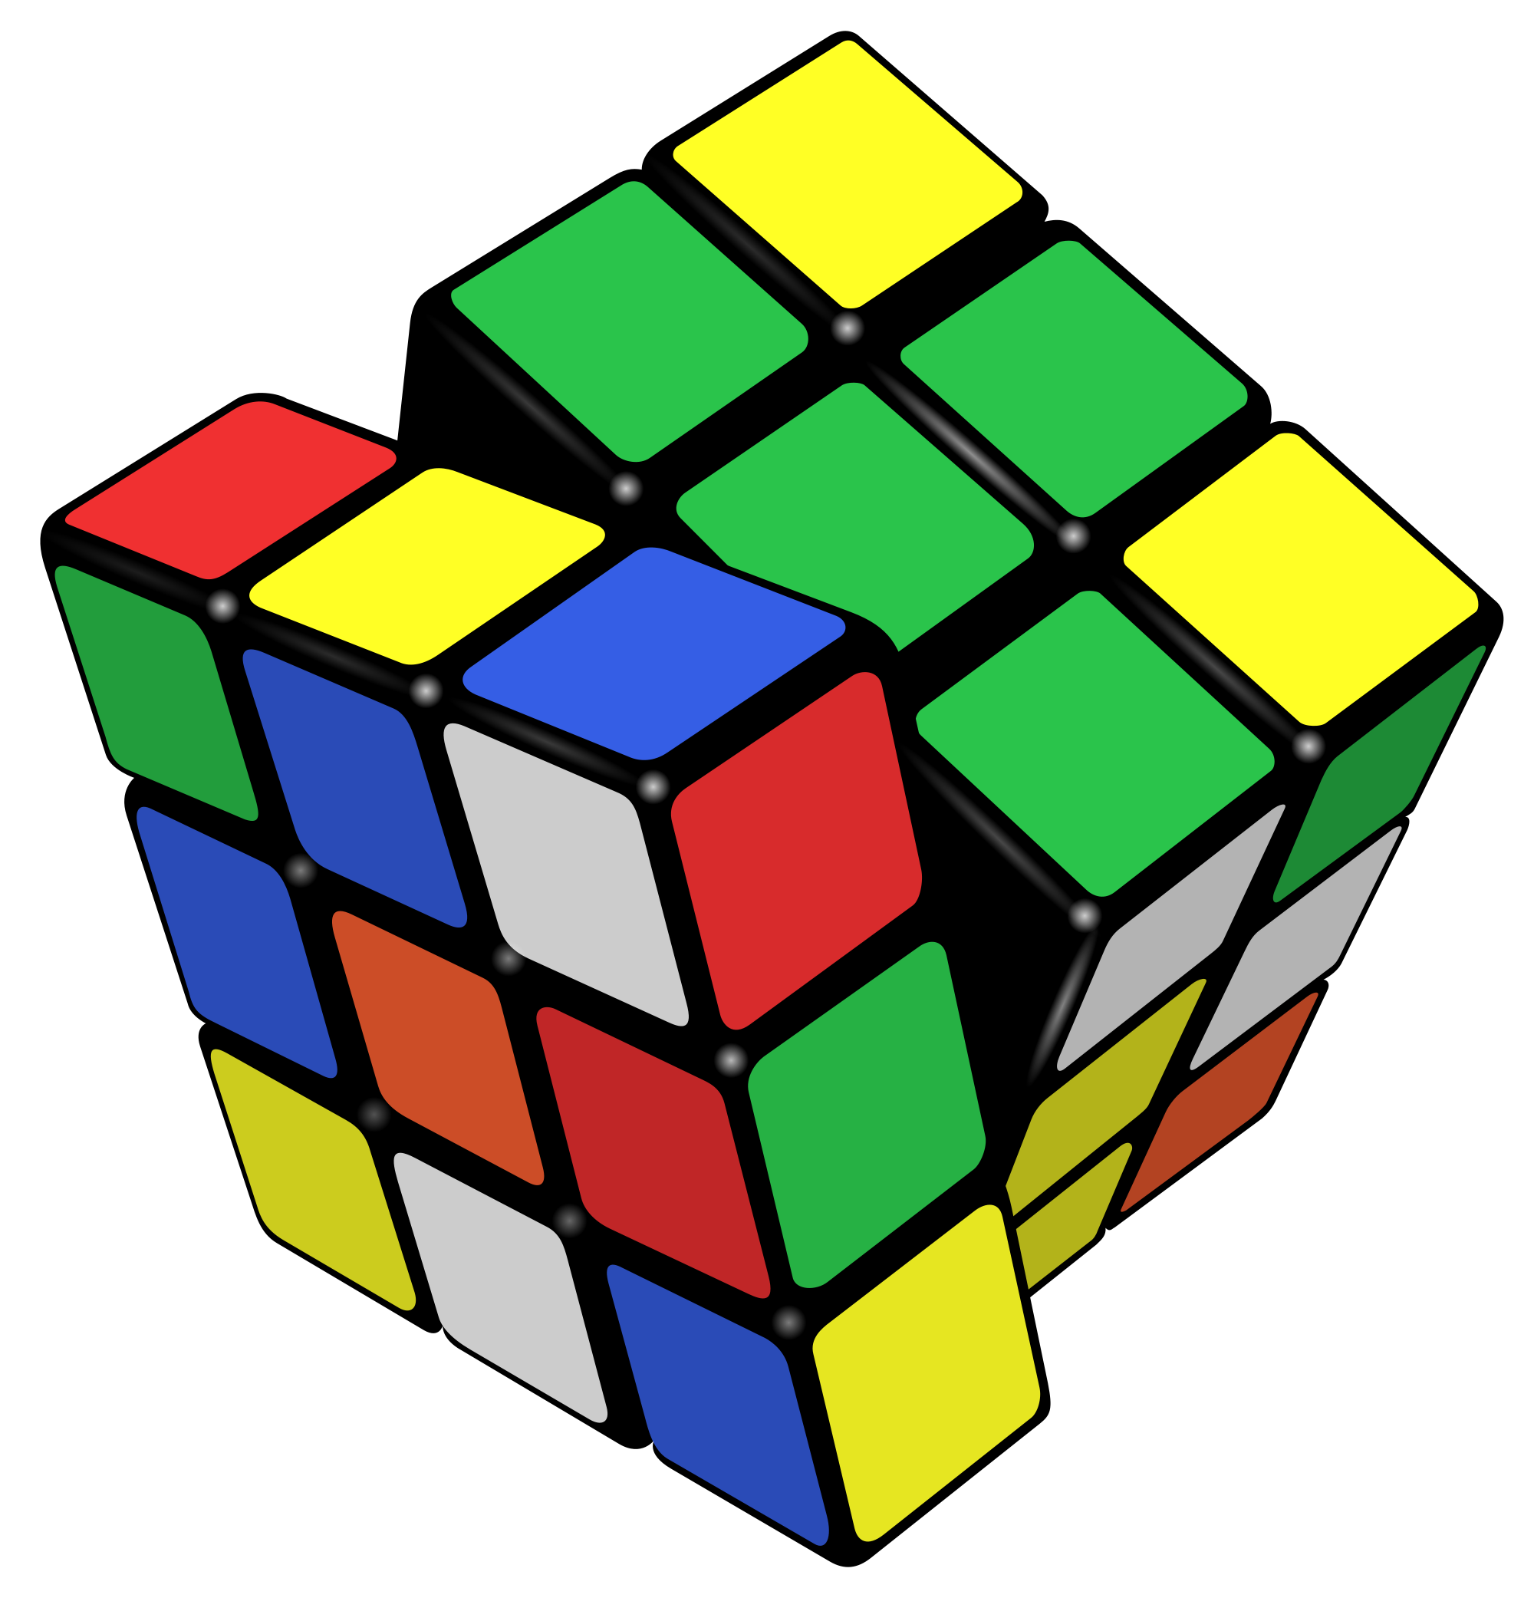
Example: Rubik’s Cube
What low-level interactions can you have?
What high-level interactions can you have?

Slide 11
Part I: High Level
Interaction with
Data / Problem Space

Slide 12
High-level interactions with a visualization correspond to analysis tasks
We can think about why users perform tasks (interactions) at different levels of specificity
High – consume vs. produce
Mid – search
Low – query
Brehmer and Munzner (2013)
M. Brehmer and T. Munzner, "A Multi-Level Typology of Abstract Visualization Tasks," in IEEE Transactions on Visualization and Computer Graphics, vol. 19, no. 12, pp. 2376-2385, Dec. 2013, doi: 10.1109/TVCG.2013.124.

Slide 13
Consume
Learn
Read a data story; be guided through a series of cognitive operations
Discover
Generation and verification of hypotheses, associated with models of scientific inquiry
Enjoy
Casual encounters with visualization
User is not driven by a need to verify or generate a hypothesis; novelty stimulates curiosity and exploration
Produce
Generate
Create new artifacts such as transformed or derived data, annotation, recorded interactions, screenshots
Consume vs. Produce
Notes:
Presentation using visualization may take place within the context of decision making, planning, forecasting, and instructional processes
Discover - Scientific investigation may be motivated by existing theories, models, and hypotheses, or by the serendipitous observation of unexpected phenomena
Enjoy - Casual encounters with visualization can be fleeting, such as in the earlier example of encountering a static choropleth electoral map while reading a blog post. Conversely, these encounters might be immersive and time-consuming experiences, such as in museum settings

Slide 14
Process of the user finding elements of interest in the visualization
Search is categorized based on:
If the target of the search is known a priori
If the location of the target is known a priori
Search
 | Target Known | Target Unknown
Location known | User is familiar with American geography and looking for CA on a choropleth map | User using a tree visualization is searching within a specific subtree for leaf nodes having few siblings
Location Unknown | User is unfamiliar with American geography and looking for CA on a choropleth map | User is searching for outliers in a scatterplot

Slide 15
Once a target or set of targets has been found a user may
Identify
Returns characteristics about the target
Ex. User of a choropleth map identifies the margin of victory for the winning election candidate in CA
Compare
Refers to multiple subsets of targets
Ex. User of a choropleth map identifies election results for CA and compares them to results for MA
Summarize
Refers to a whole set of targets
Ex. User of a choropleth map summarizes election results across all states
the targets
Query

Slide 16
Part II: Low Level
Interaction with
a Visual Interface

Slide 17
Yi, Kang, Stasko and Jacko (2007)
Select: mark something as interesting
Explore: show me something else
Reconfigure: show me a different arrangement
Encode: show me a different representation
Abstract/Elaborate: show me more or less detail
Filter: show me something conditionally
Connect: show me related items
Yi, J. S., ah Kang, Y., Stasko, J. T., & Jacko, J. A. (2007). Toward a deeper understanding of the role of interaction in information visualization. Visualization and Computer Graphics, IEEE Transactions on, 13(6), 1224-1231.

Slide 18
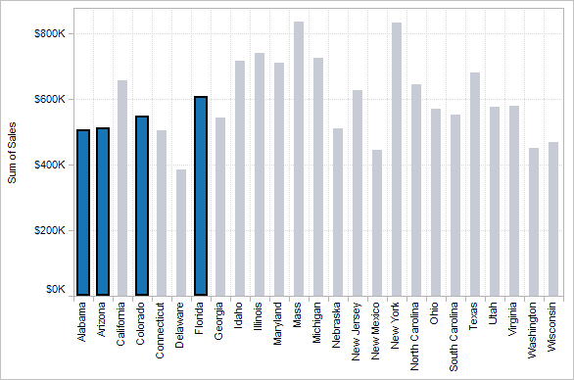
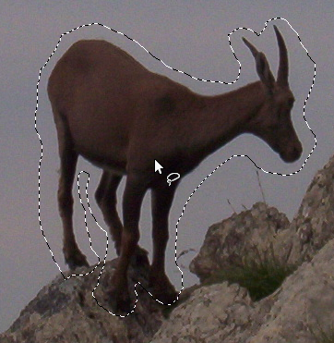

1. Select
Mark something as interesting: direct

Slide 19
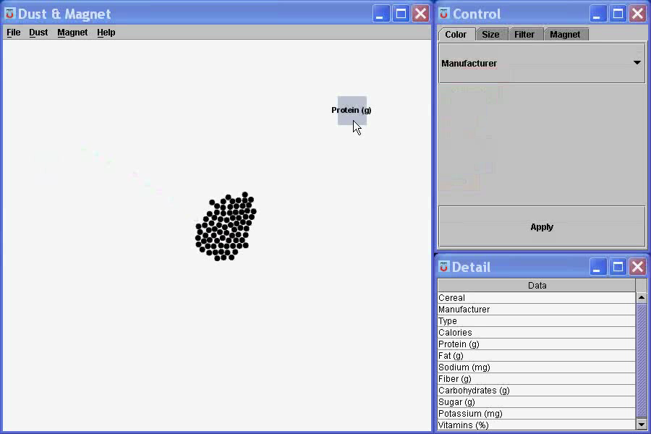
Mark something as interesting: indirect
1. Select
Notes:
What are you selecting? One item at a time?
Selecting of a value?
Selecting of a range?
Selecting of a position on the screen?

Slide 20
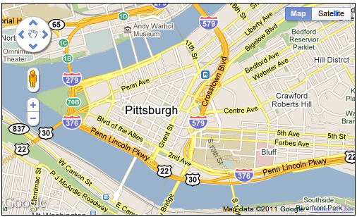
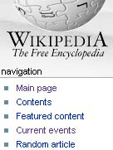
Show me something else
Scroll bars
Panning
Direct-Walk (e.g. hyperlink traversal)
2. Explore

Slide 21
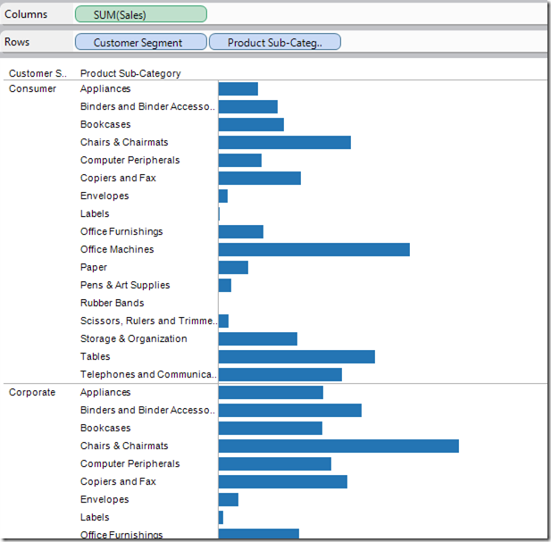
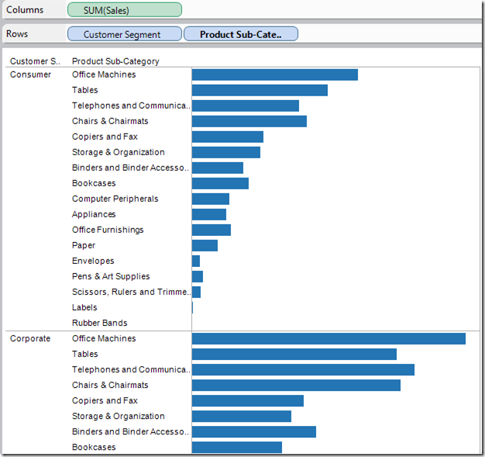
3. Reconfigure
Show me a different arrangement: sorting

Slide 22
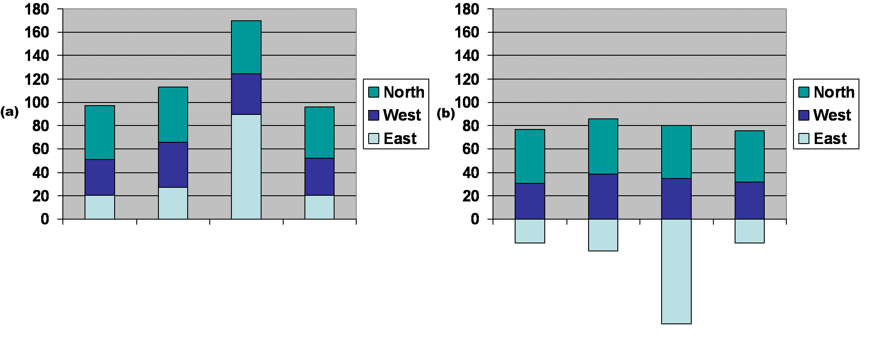
3. Reconfigure
Show me a different arrangement: baseline adjustment

Slide 23
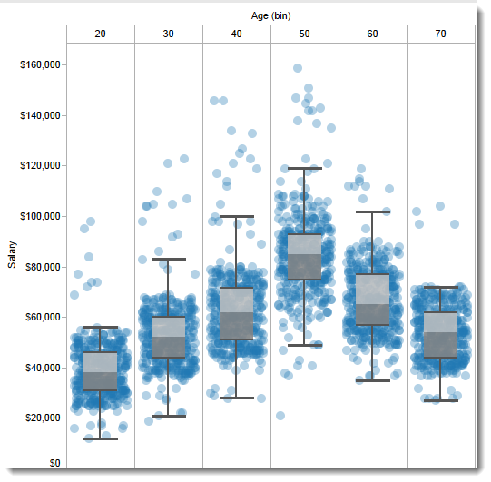
Show me a different arrangement: reduce occlusion (jitter)
3. Reconfigure

Slide 24
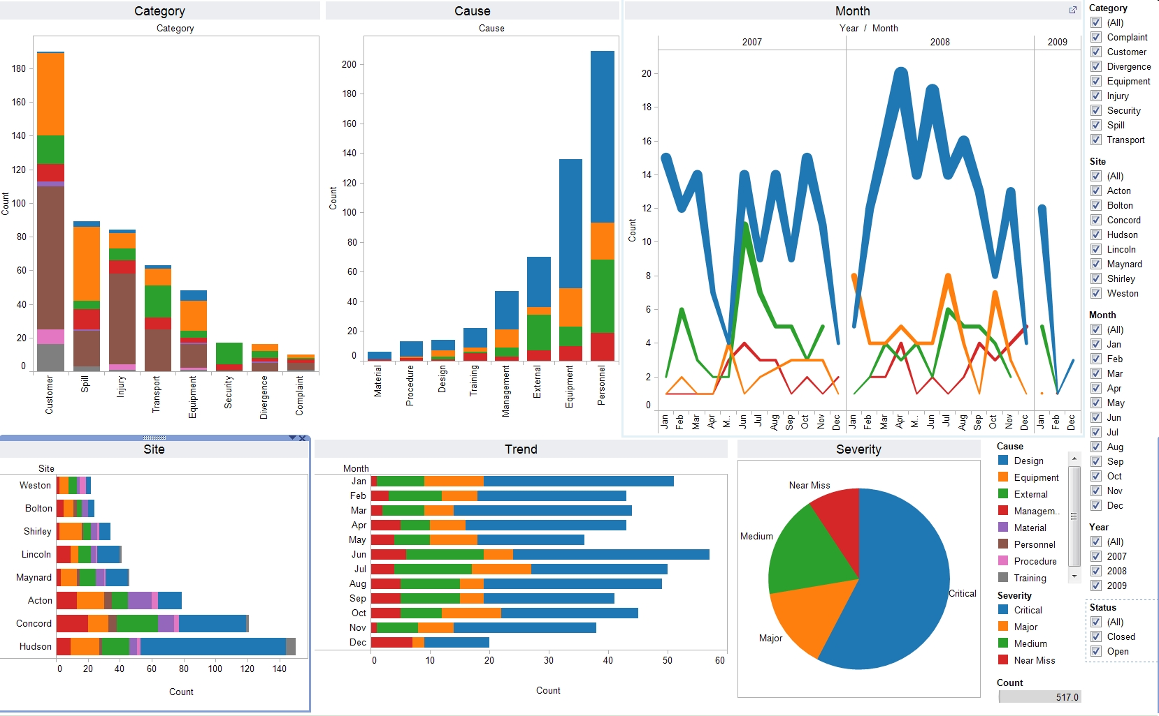
4. Encode
Show me a different representation: visualization type, color, size, orientation, etc.

Slide 25
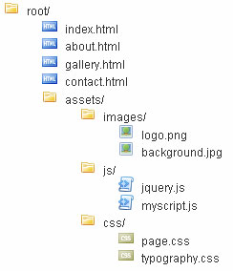
5. Abstract / Elaborate
Show me more or less detail: drill up/down

Slide 26
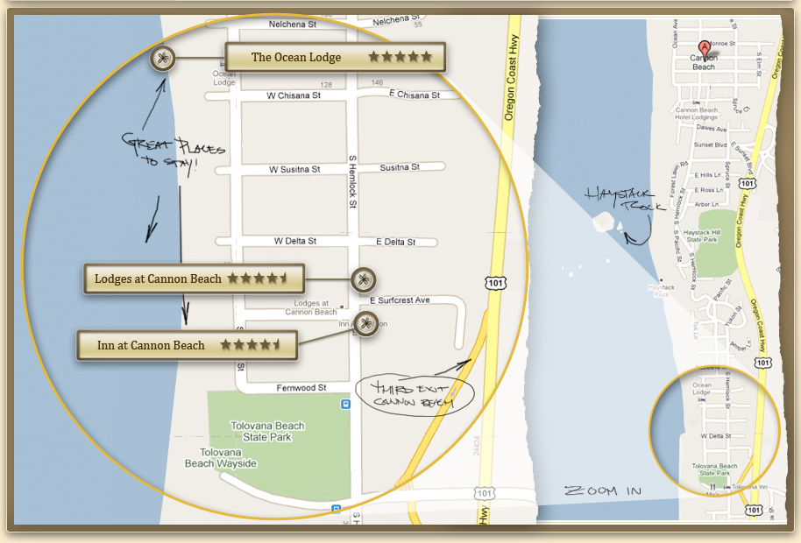
5. Abstract / Elaborate
Show me more or less detail: zooming

Slide 27
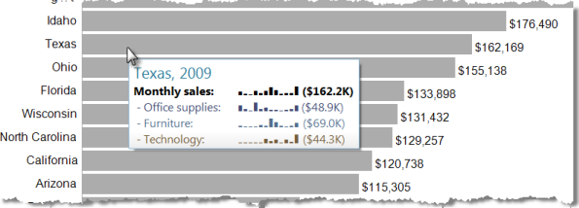
5. Abstract / Elaborate
Show me more or less detail: tooltips

Slide 28
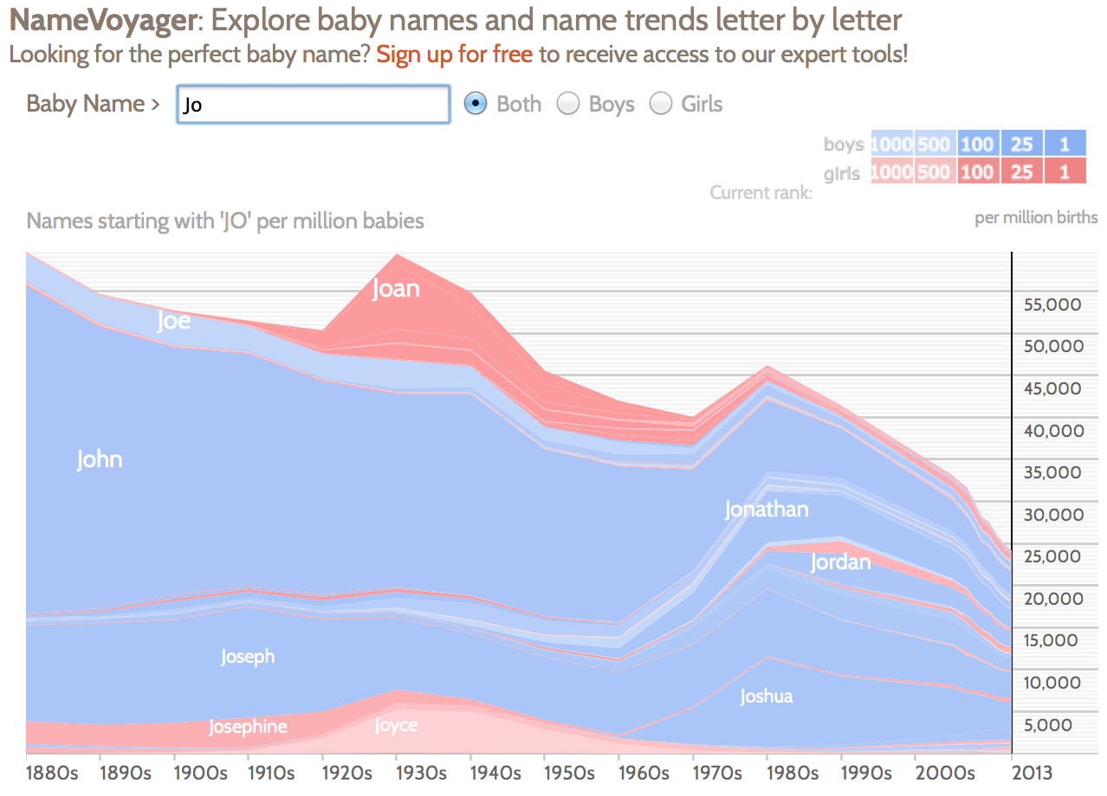
Show me something conditionally
6. Filter

Slide 29
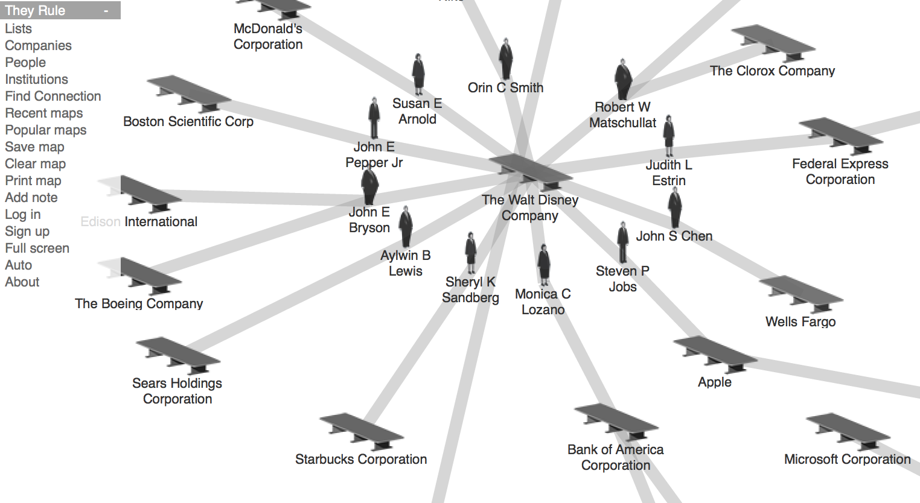
7. Connect
Show me related items: build-out

Slide 30
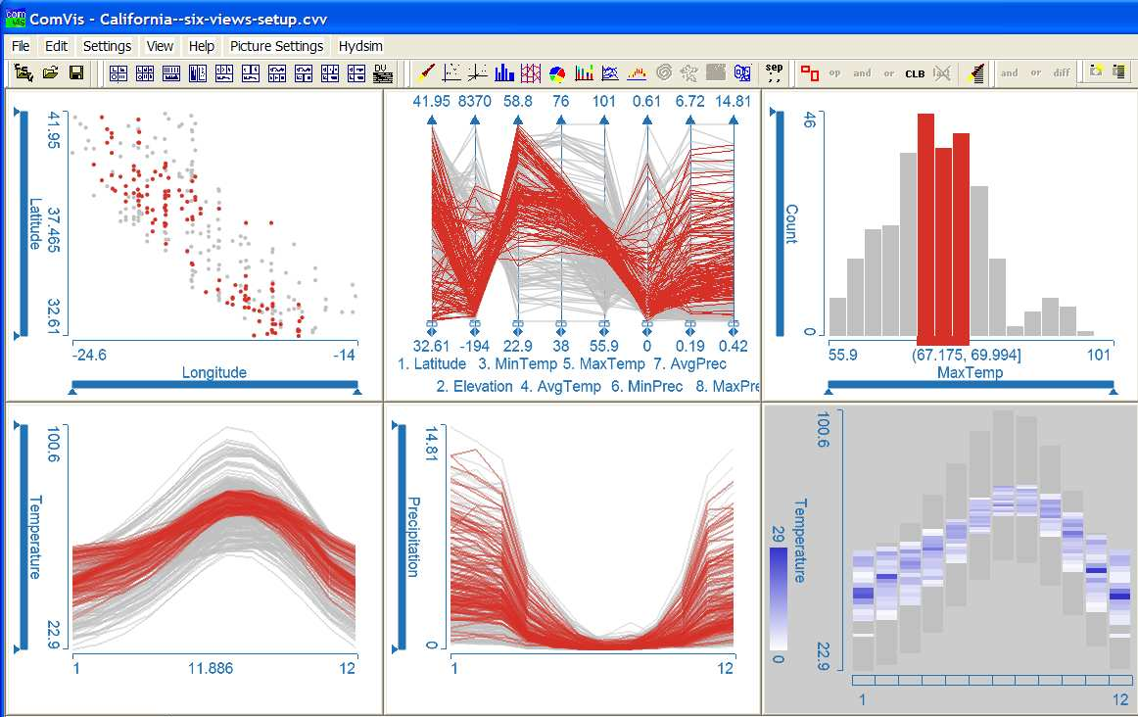
Show me related items: coordinated multiple views (CMV)
7. Connect

Slide 31
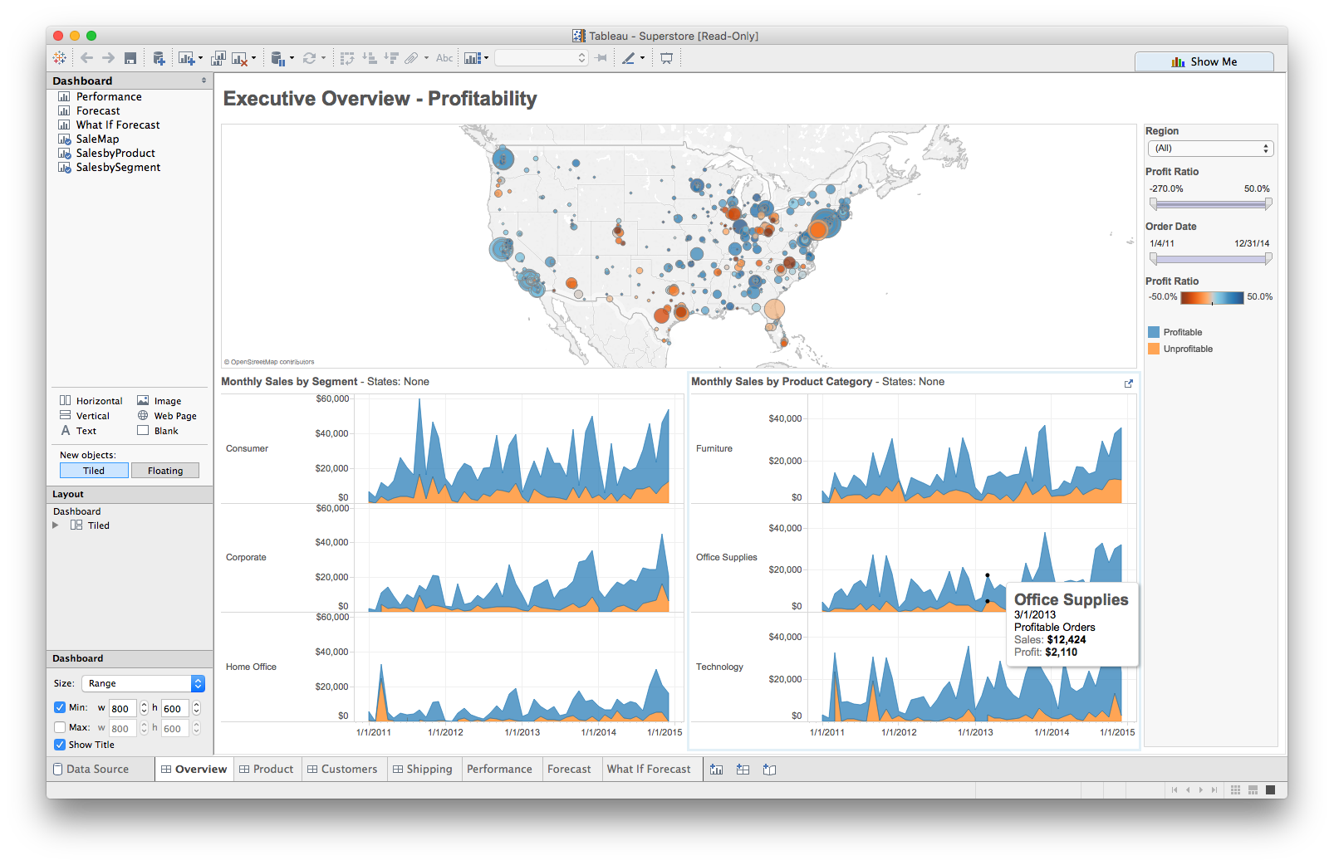
Multiple views
Different
representations
Different
data
Systems that use two or more distinct views
to support the exploration of a single concept or domain

Slide 32
Suggested questions to ask when designing
What is the goal of the analysis?
Decision-making
Better understand a domain or a problem
Identify the trends of a phenomenon
Forecast the future
…etc.
What kinds of operations do we need to enable?
How can the visualization support those operations?

Slide 33
Tableau CMV walkthrough and exploration
Demo: coordinated multiple views

